Slide 1


Slide 2
Passenger volumes
Gather missing data
Project future growth
Describe historical trends

Slide 3


Slide 4

Step 1: gather data

Slide 5
 |  | 2008 | 2009 | 2010 | 2011 | 2012 | 2013 | 2014
Passengers (in million) | Total | 736.47 | 697.99 | 713.77 | 725.99 | 732.95 | 740.18 | 759.87
 | Total from BTS | 740.46 | 701.16 | 717.74 | 728.37 | 734.32 | 740.86 | 761.00
 | BTS/MarketLine | 100.54% | 100.45% | 100.56% | 100.33% | 100.19% | 100.09% | 100.15%

Slide 7
2015 Passenger Volume
631M Domestic
168M International
798M Total

Slide 8
2016 Passenger Volume
664M Domestic
176M International
840M Total

Slide 9
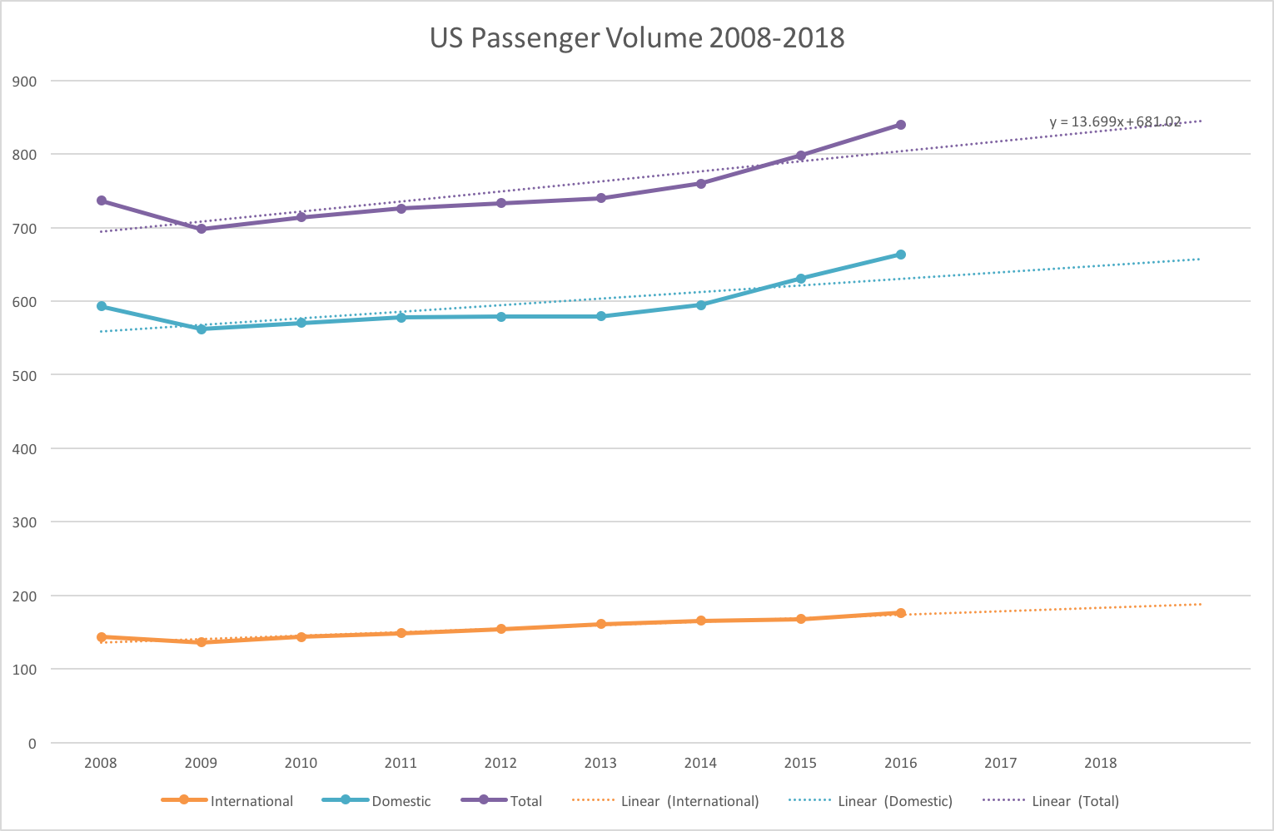

Slide 10
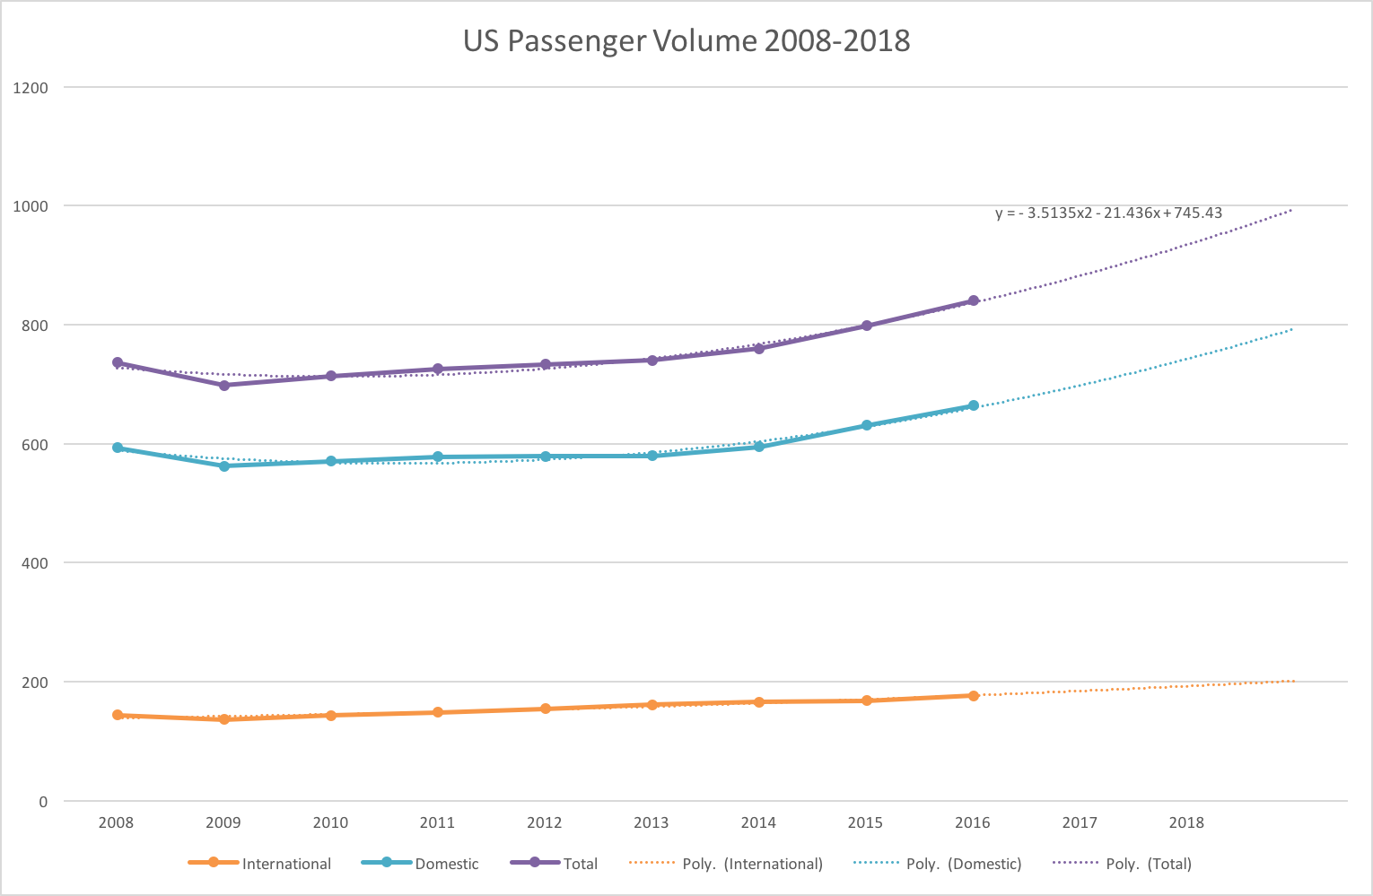

Slide 11
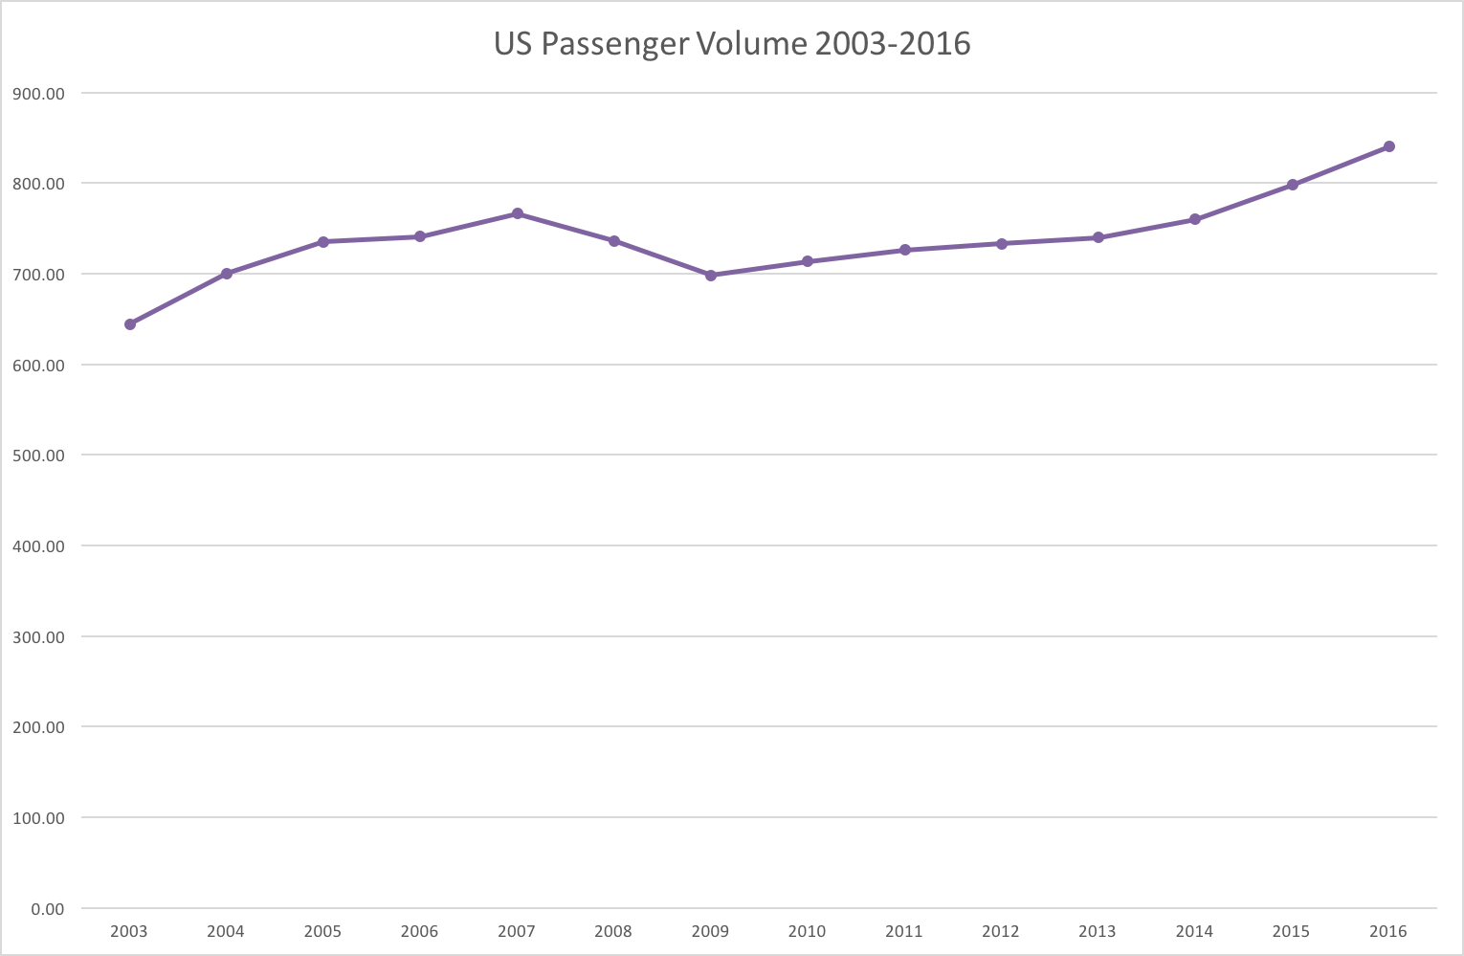

Slide 12
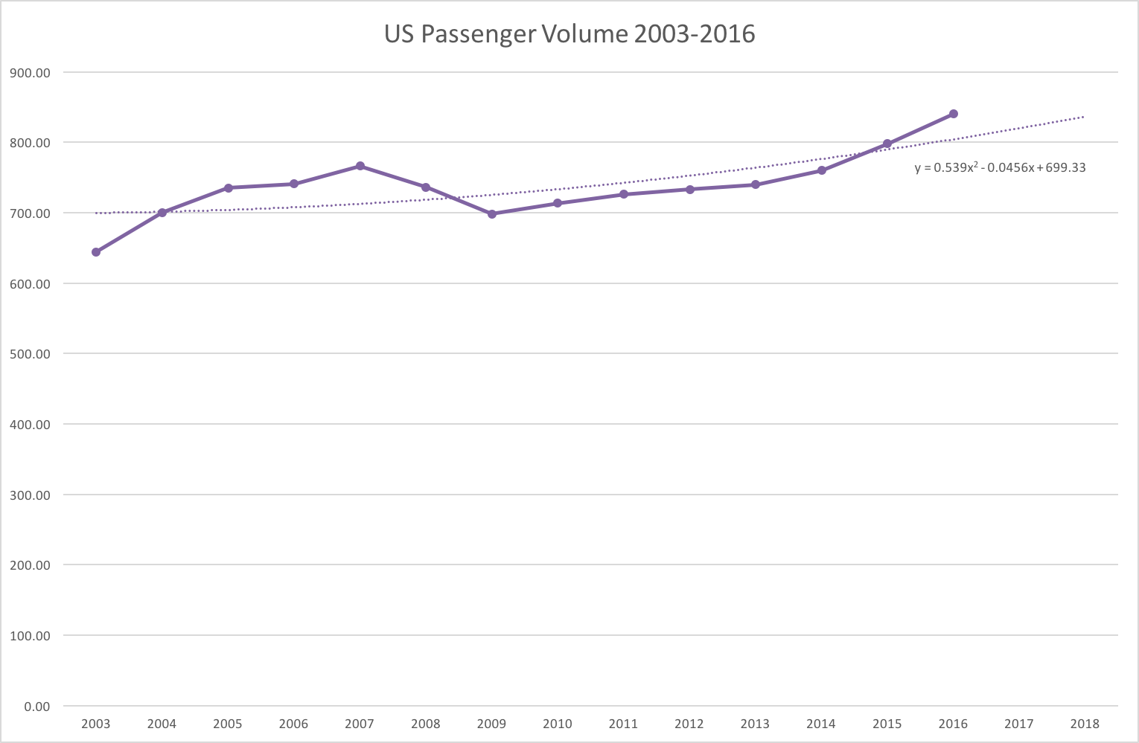

Slide 13
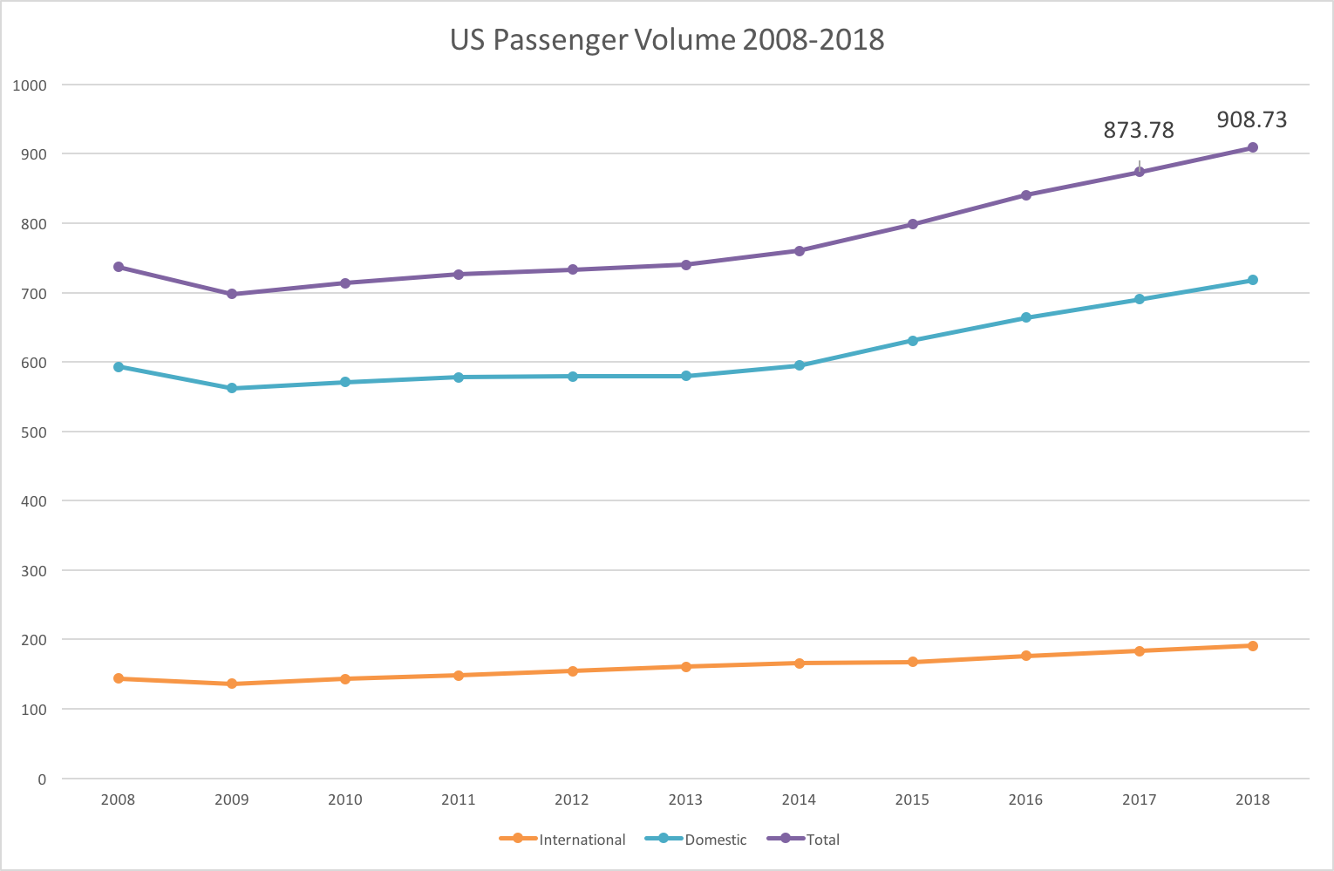

Slide 14
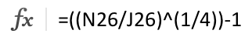
 | 2008 | 2009 | 2010 | 2011 | 2012 | 2013 | 2014 | 2015 | 2016 | 2017 | 2018
Passengers (in million) | 736.47 | 697.99 | 713.77 | 725.99 | 732.95 | 740.18 | 759.87 | 798.23 | 840.17 | 873.78 | 908.73 |  | CAGR 2008 – 2014 | CAGR 2014 – 2018
 |  | -5.22% | 2.26% | 1.71% | 0.96% | 0.99% | 2.66% | 5.05% | 5.25% | 4.00% | 4.00% |  | 0.52% | 4.57%

Slide 15


Slide 16
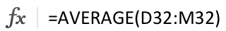
B) |  |  |  |  |  |  |  |  |  |  |  |  |  | Average number of passengers 2010 – 19
Table 1. World's passenger volume carried in domestic and international flights
 |  |  | 2010 | 2011 | 2012 | 2013 | 2014 | 2015 | 2016 | 2017 | 2018 | 2019
Canada | Volume | millions | 54.53 | 56.62 | 59.44 | 61.06 | 64.73 | 67.96 | 71.23 | 74.49 | 77.71 | 80.97 |  | 66.87
Mexico | Volume | millions | 50.40 | 52.41 | 56.77 | 61.49 | 66.63 | 69.89 | 72.81 | 76.35 | 80.08 | 84.09 |  | 67.09
Brazil | Volume | millions | 66.24 | 76.73 | 82.34 | 82.43 | 90.02 | 96.45 | 103.22 | 110.95 | 119.37 | 128.72 |  | 95.65
Argentina | Volume | millions | 9.93 | 9.86 | 10.74 | 11.21 | 11.82 | 12.37 | 12.91 | 13.45 | 14.00 | 14.54 |  | 12.08
Chile | Volume | millions | 11.06 | 12.99 | 15.23 | 16.48 | 17.31 | 18.97 | 20.62 | 22.39 | 24.31 | 26.40 |  | 18.58

Slide 17

Comparing France with Canada, 2015
France: 84.90M passengers
Canada: 67.96M passengers
France has 25% more passengers

Slide 18
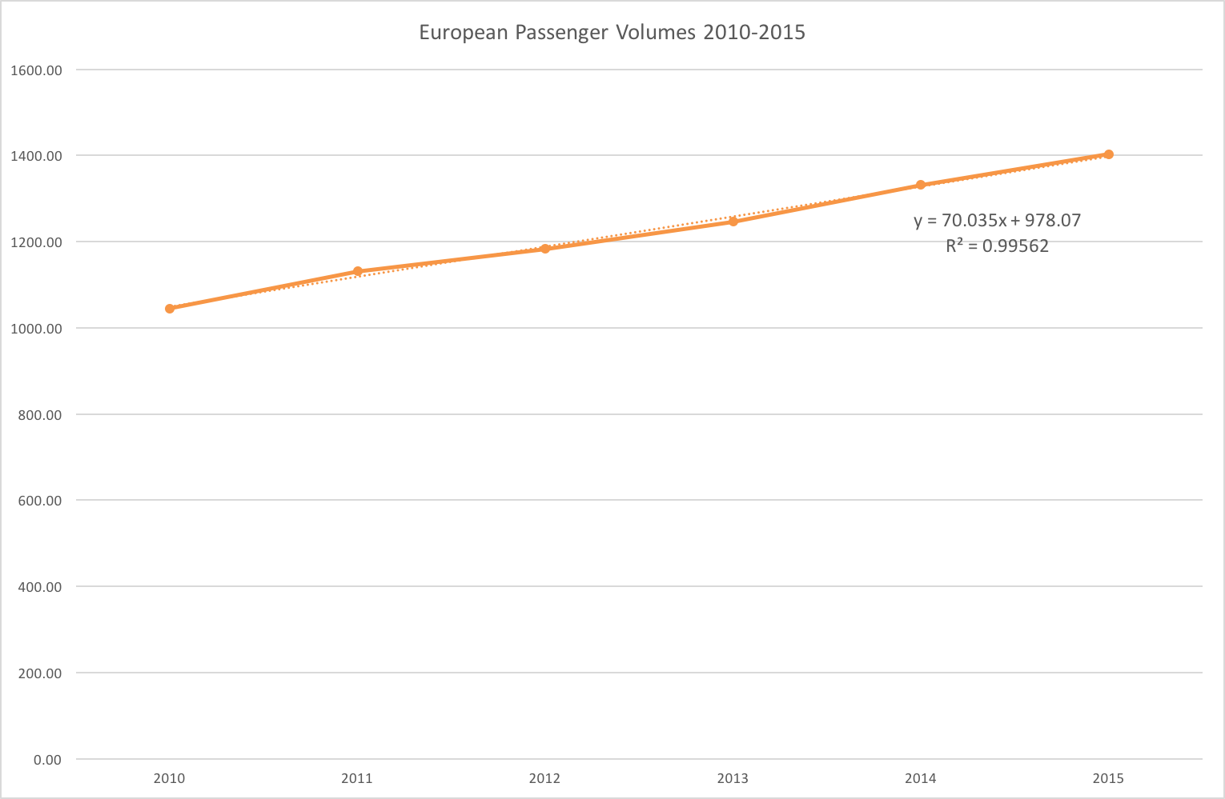

Slide 19
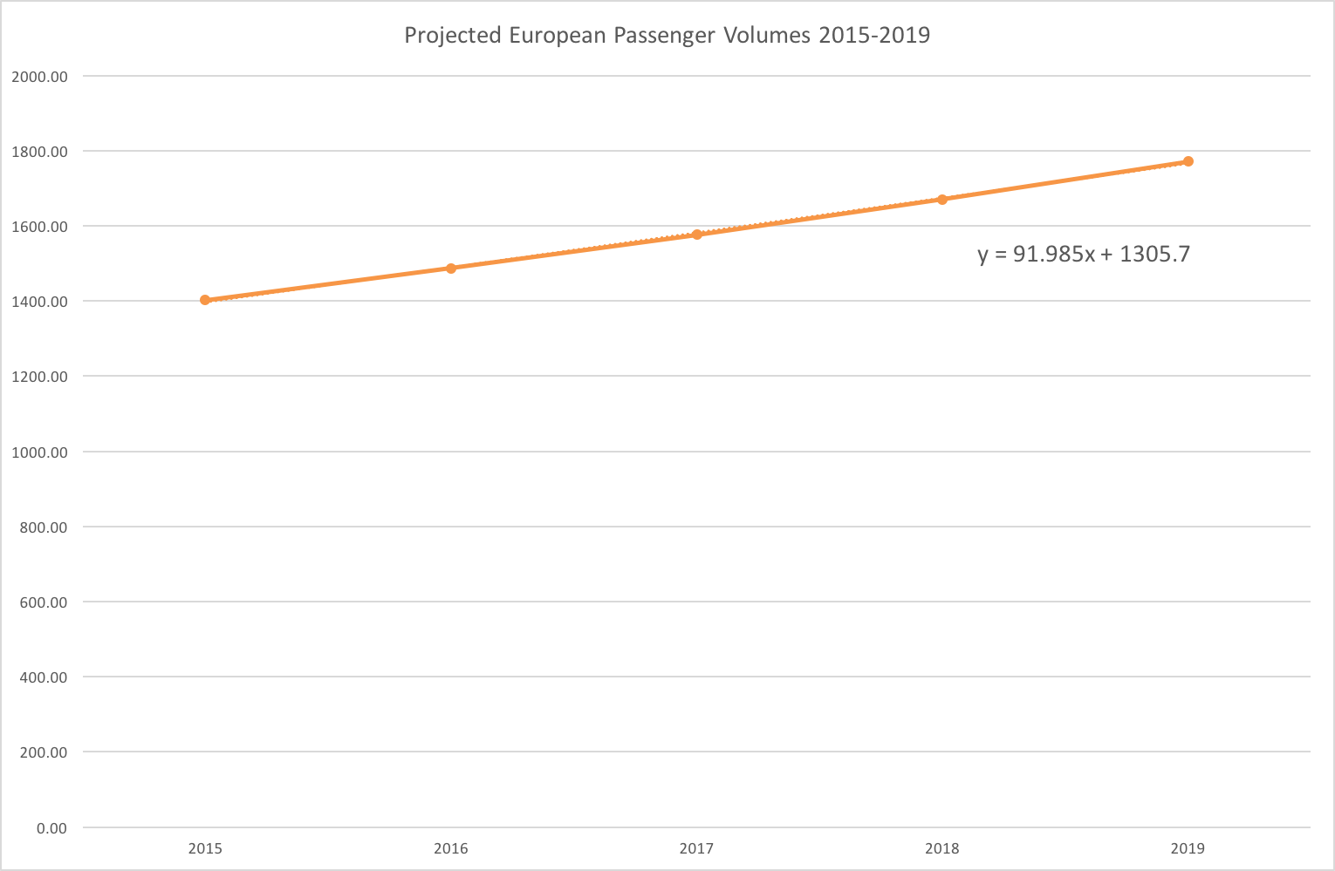

Slide 20
Summary
Reliable source for missing data
Historical trend shows vulnerability
Cautious optimism for future growth

